Slide 1

Gulf Coast Emergency Migration + Management
Al-Jalil Gault | Andrew Renninger | Cloud Computing + Visualization
Illustration: Sarah Grillo/Axios

Slide 2
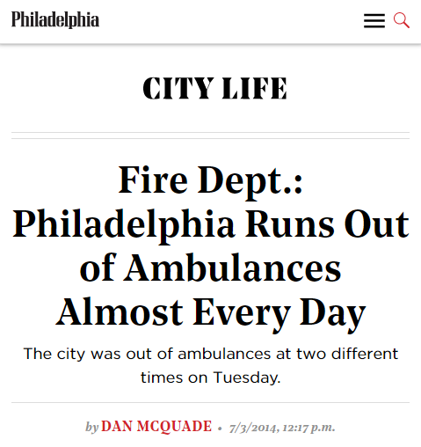
Delays in Emergency Medical Services are an Imminent Threat
A Study of North Los Angeles County, found that 14.8% of EMS calls were delayed.
The average time of the delay was 35 mins.
Photo: Aftermath of Hurricane Delta, Creole, Louisiana Oct 2020

Slide 3
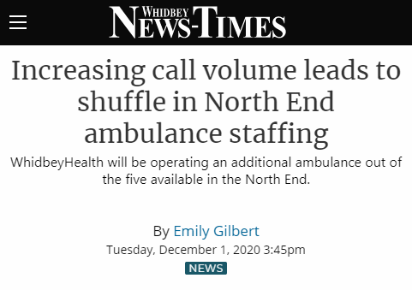
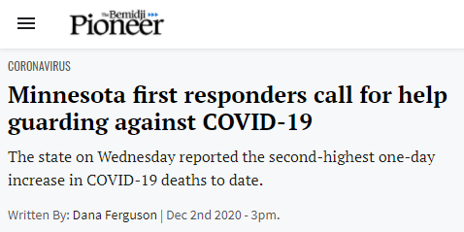
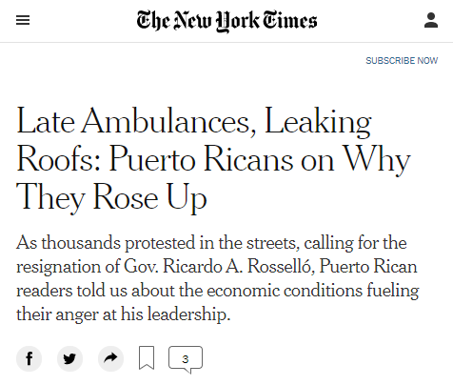
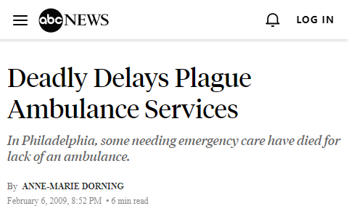
We Must Plan for Adjustments

Slide 4

Knowledge for those in need:
An easy-to-use App

Slide 5
Photo: Office of Sustainability
Residential & Commercial Buildings
Policies should focus on assessing energy performance, reducing energy consumption, and incentivizing efficiency.

Slide 6

Strict Energy Codes
NY Stretch Energy Code - 2020
New York State Energy Research and Development Authority (NYSERDA) developed the optional NY Stretch Energy Code to help local jurisdictions meet energy and climate goals. This code exceeds efficiency from the International Energy Conservation Code (IECC), the prevailing international energy building code.
Example, Lighting Power Allowances:
NY Stretch Code IECC
Office 0.69 w/sq.ft 0.79 w/sq.ft
Retail 0.91 w/sq.ft 1.06 w/sq.ft
“stretch codes”:
Codes that are more energy-efficient than international guidelines for the design.
Restrict use of natural gas in new multi-family construction
Berkley, San Francisco, San Jose, Mountain View, Santa Rosa, and Brisbane in California
Brookline in Massachusetts
Leverage use of National Energy Code compliance tools
RESCheck : Developed by US DOE for residential evaluation
COMCheck : Developed by US DOE for commercial evaluation
Software tools for designers and contractors to determine if building complies with energy code. Simplifies process for code officials.

Slide 7
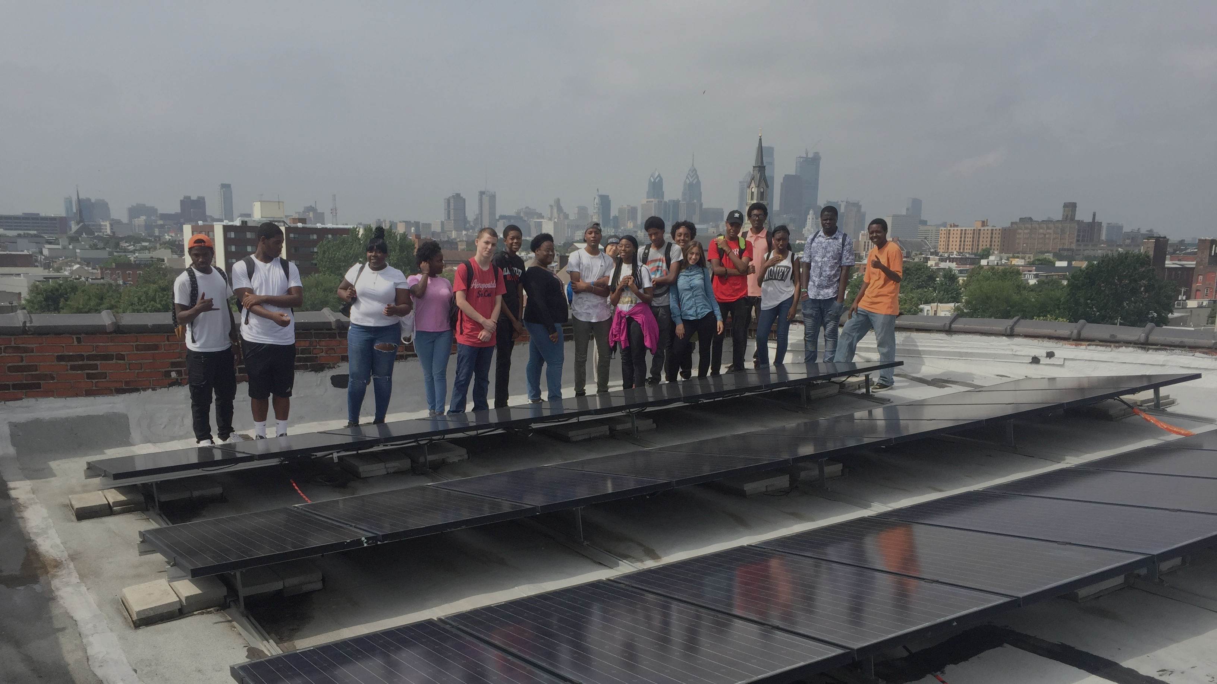
Questions ?
Al-Jalil Gault | DVRPC | Office of Energy and Climate Change Initiatives
Photo: Philadelphia Energy Company Outreach

